Slide 1
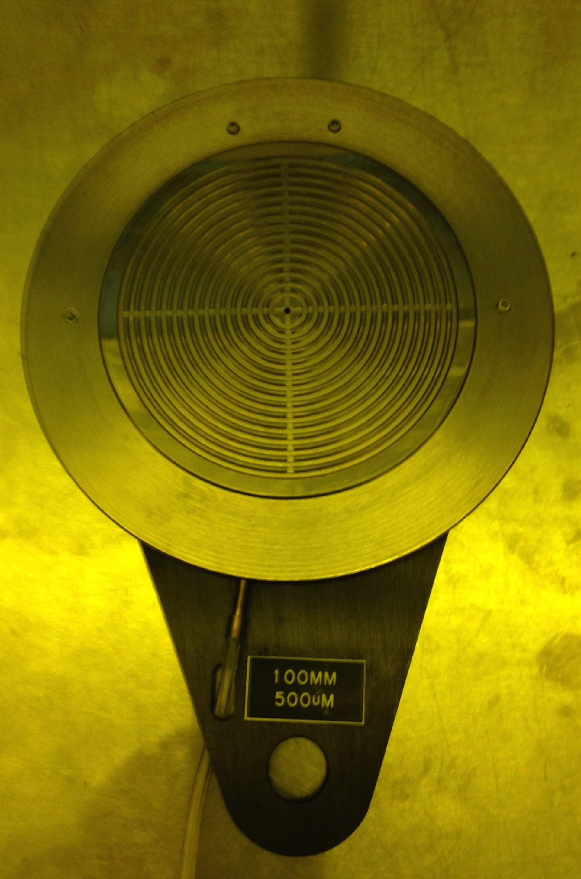
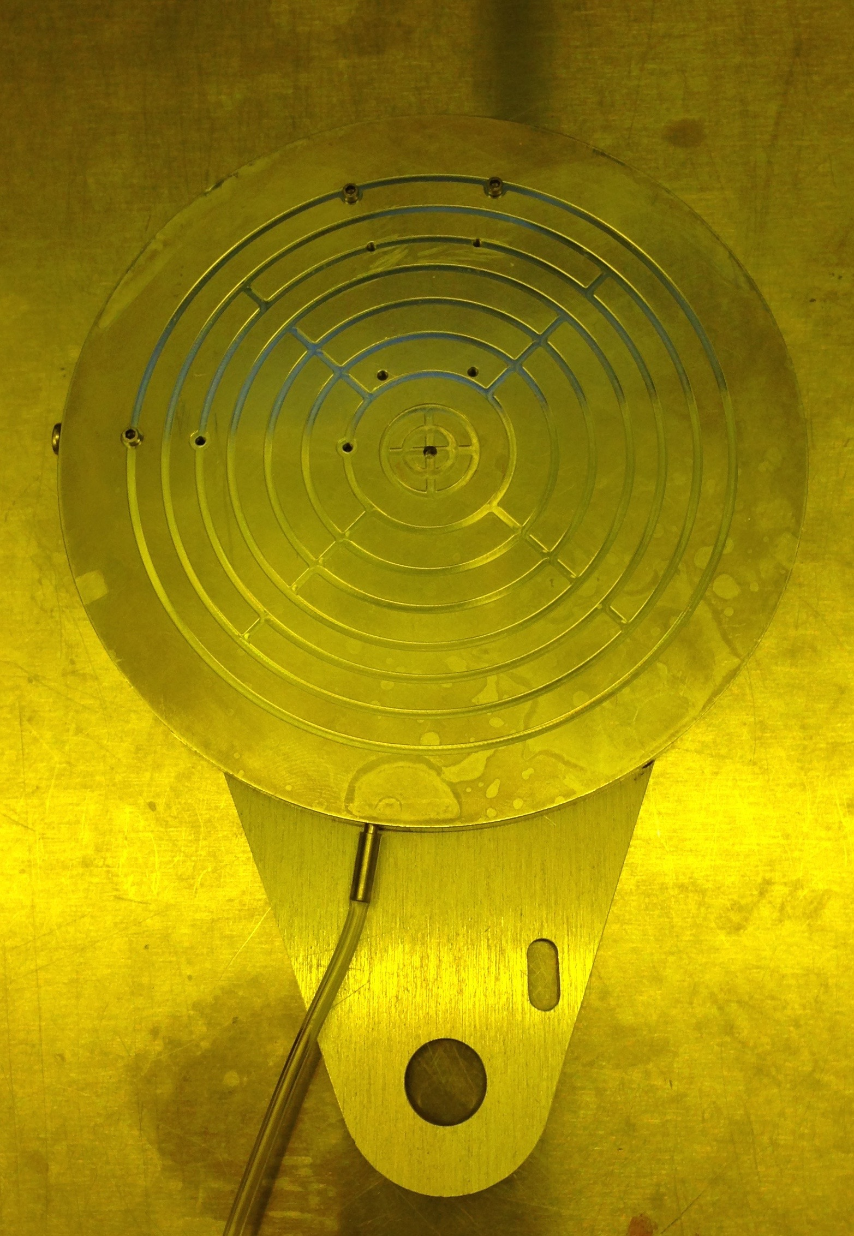
GCA 6300 chucks
STANDARD CHUCK
Substrate size: 4 inch (and smaller)
S=Substrate thickness: (0.420-0.620)mm
C=Chuck thickness (Bilja): 5.601mm
Thickness (S+C)=(5.601+0.500)mm =6.101mm
TARGET thickness=6.121mm(+/-0.100mm)
Thinner substrates (≤350um), use shim 230-260um
METAL 4” CHUCK
Substrate size: 4 inch (and smaller)
S=Substrate thickness: (0.420-0.620)mm
C=Chuck thickness(Bilja): 5.601mm
Thickness (S+C)=(5.601+0.500)mm=6.101mm
TARGET thickness=6.121mm(+/-0.100mm)
Thinner substrates (≤350um), use shim 230-260um

Slide 2
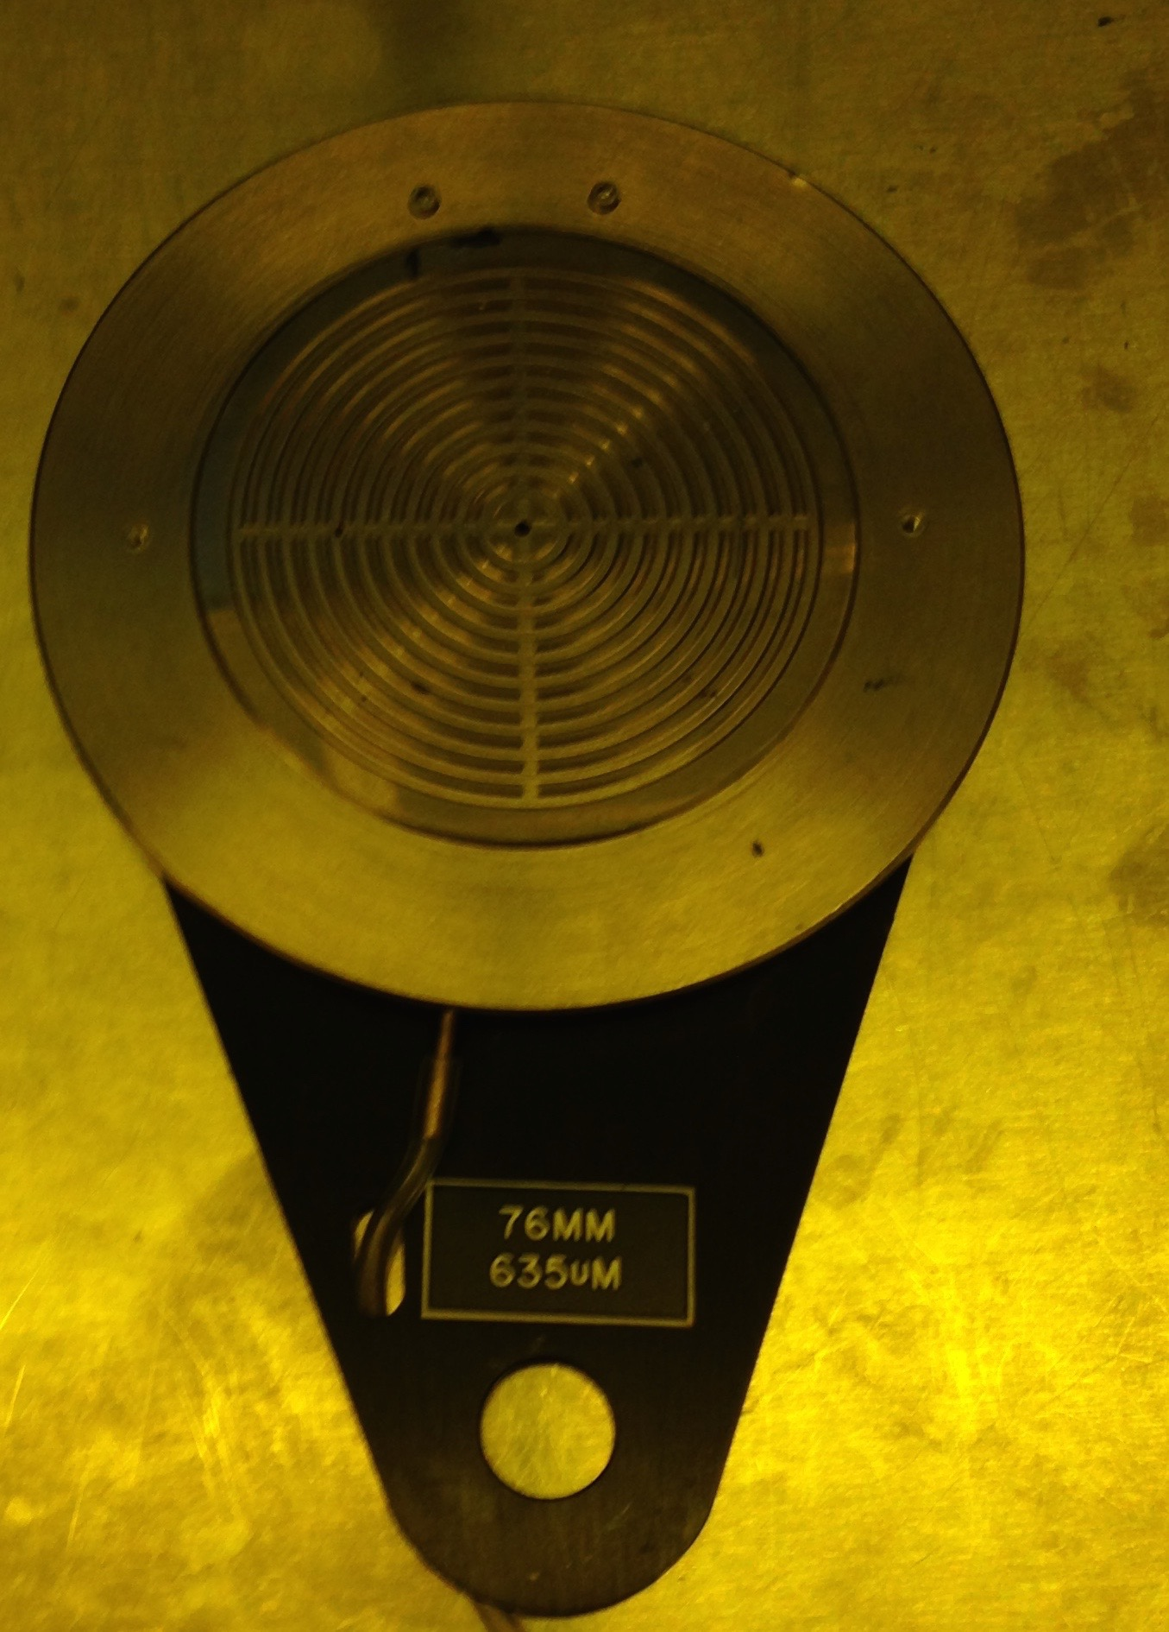
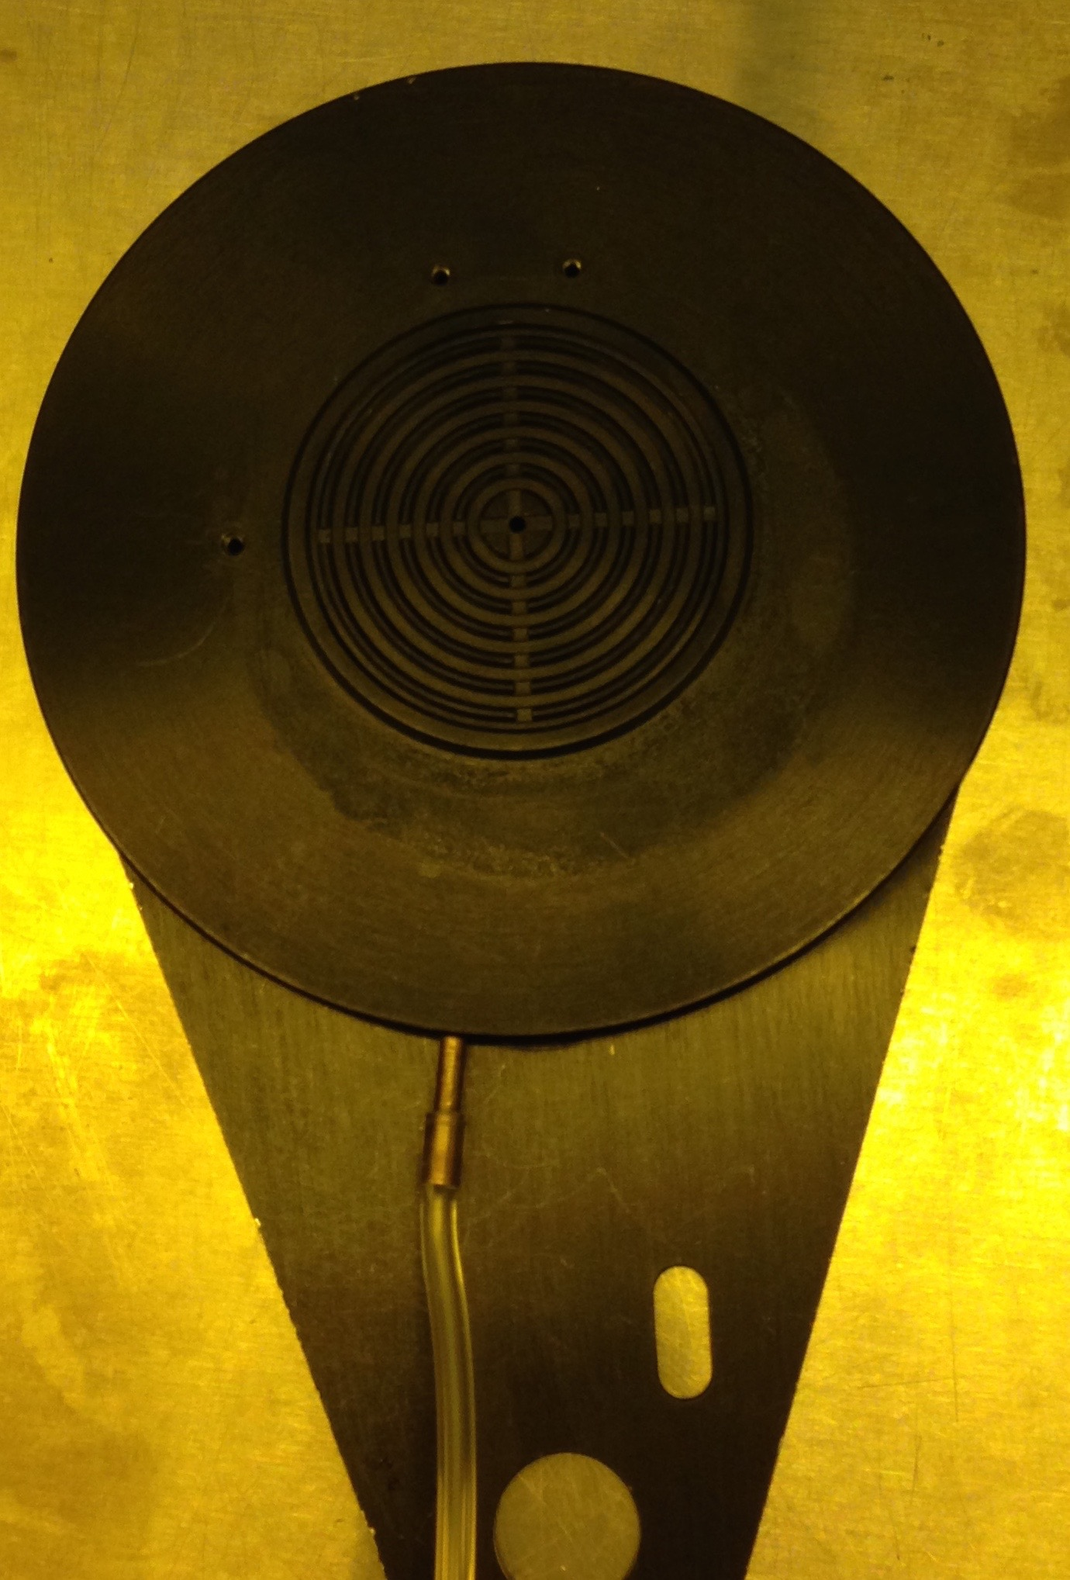
METAL 3” CHUCK
Substrate size: 3 inch (and smaller)
S=Substrate thickness: (585-785)mm
C=Chuck thickness(Bilja): 5.436mm
Thickness (S+C)=(5.436+0.635)mm=6.071mm
TARGET thickness=6.121mm(+/-0.100mm)
Thinner substrates (≤350um), use shim 380um,
Substrate~500um use shim 230um
SMALL 2” CHUCK
Substrate size: 2 inch (and smaller)
S=Substrate thickness: (0.500-0.700)mm
C=Chuck thickness(Bilja): 5.525mm
Thickness (S+C)=(5.525+0.600)mm=6.125mm
TARGET thickness=6.121mm(+/-0.100mm)
Thinner substrates (≤350um), use shim 230-260um

Slide 3
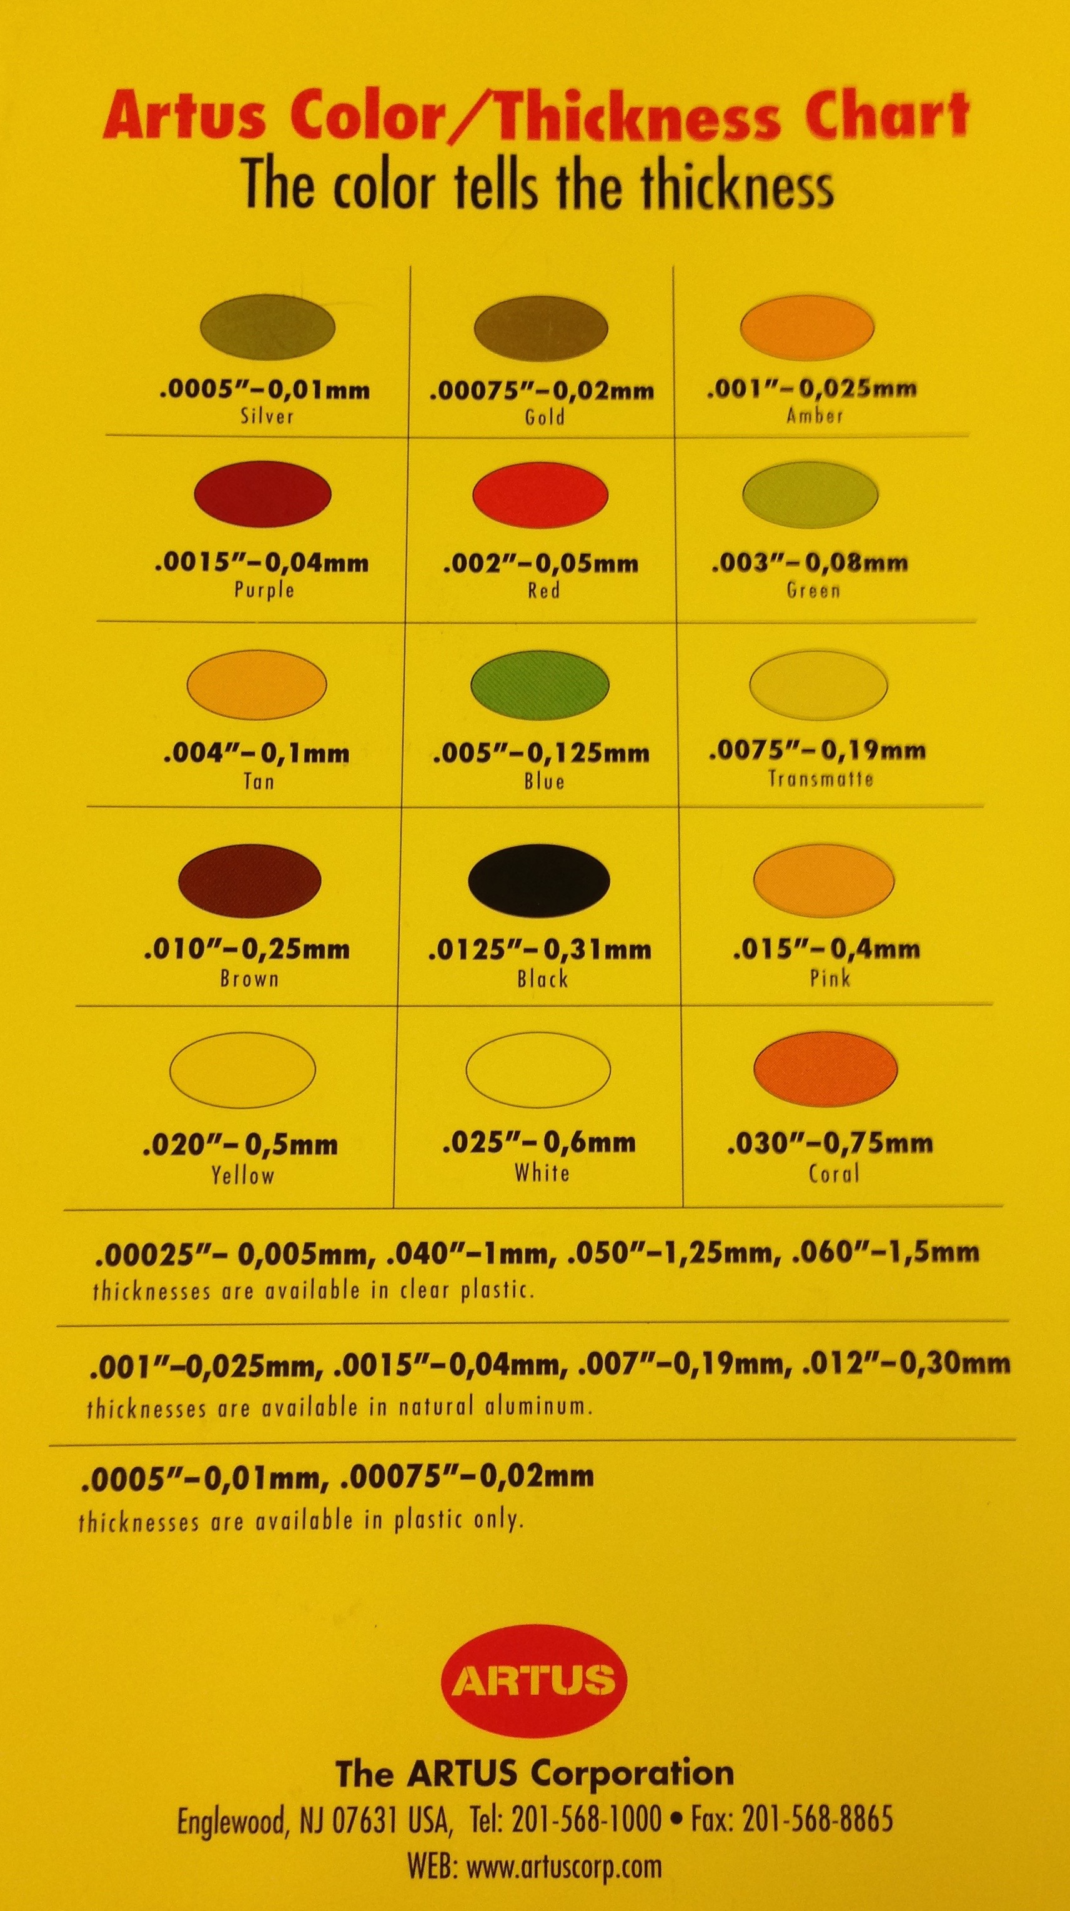
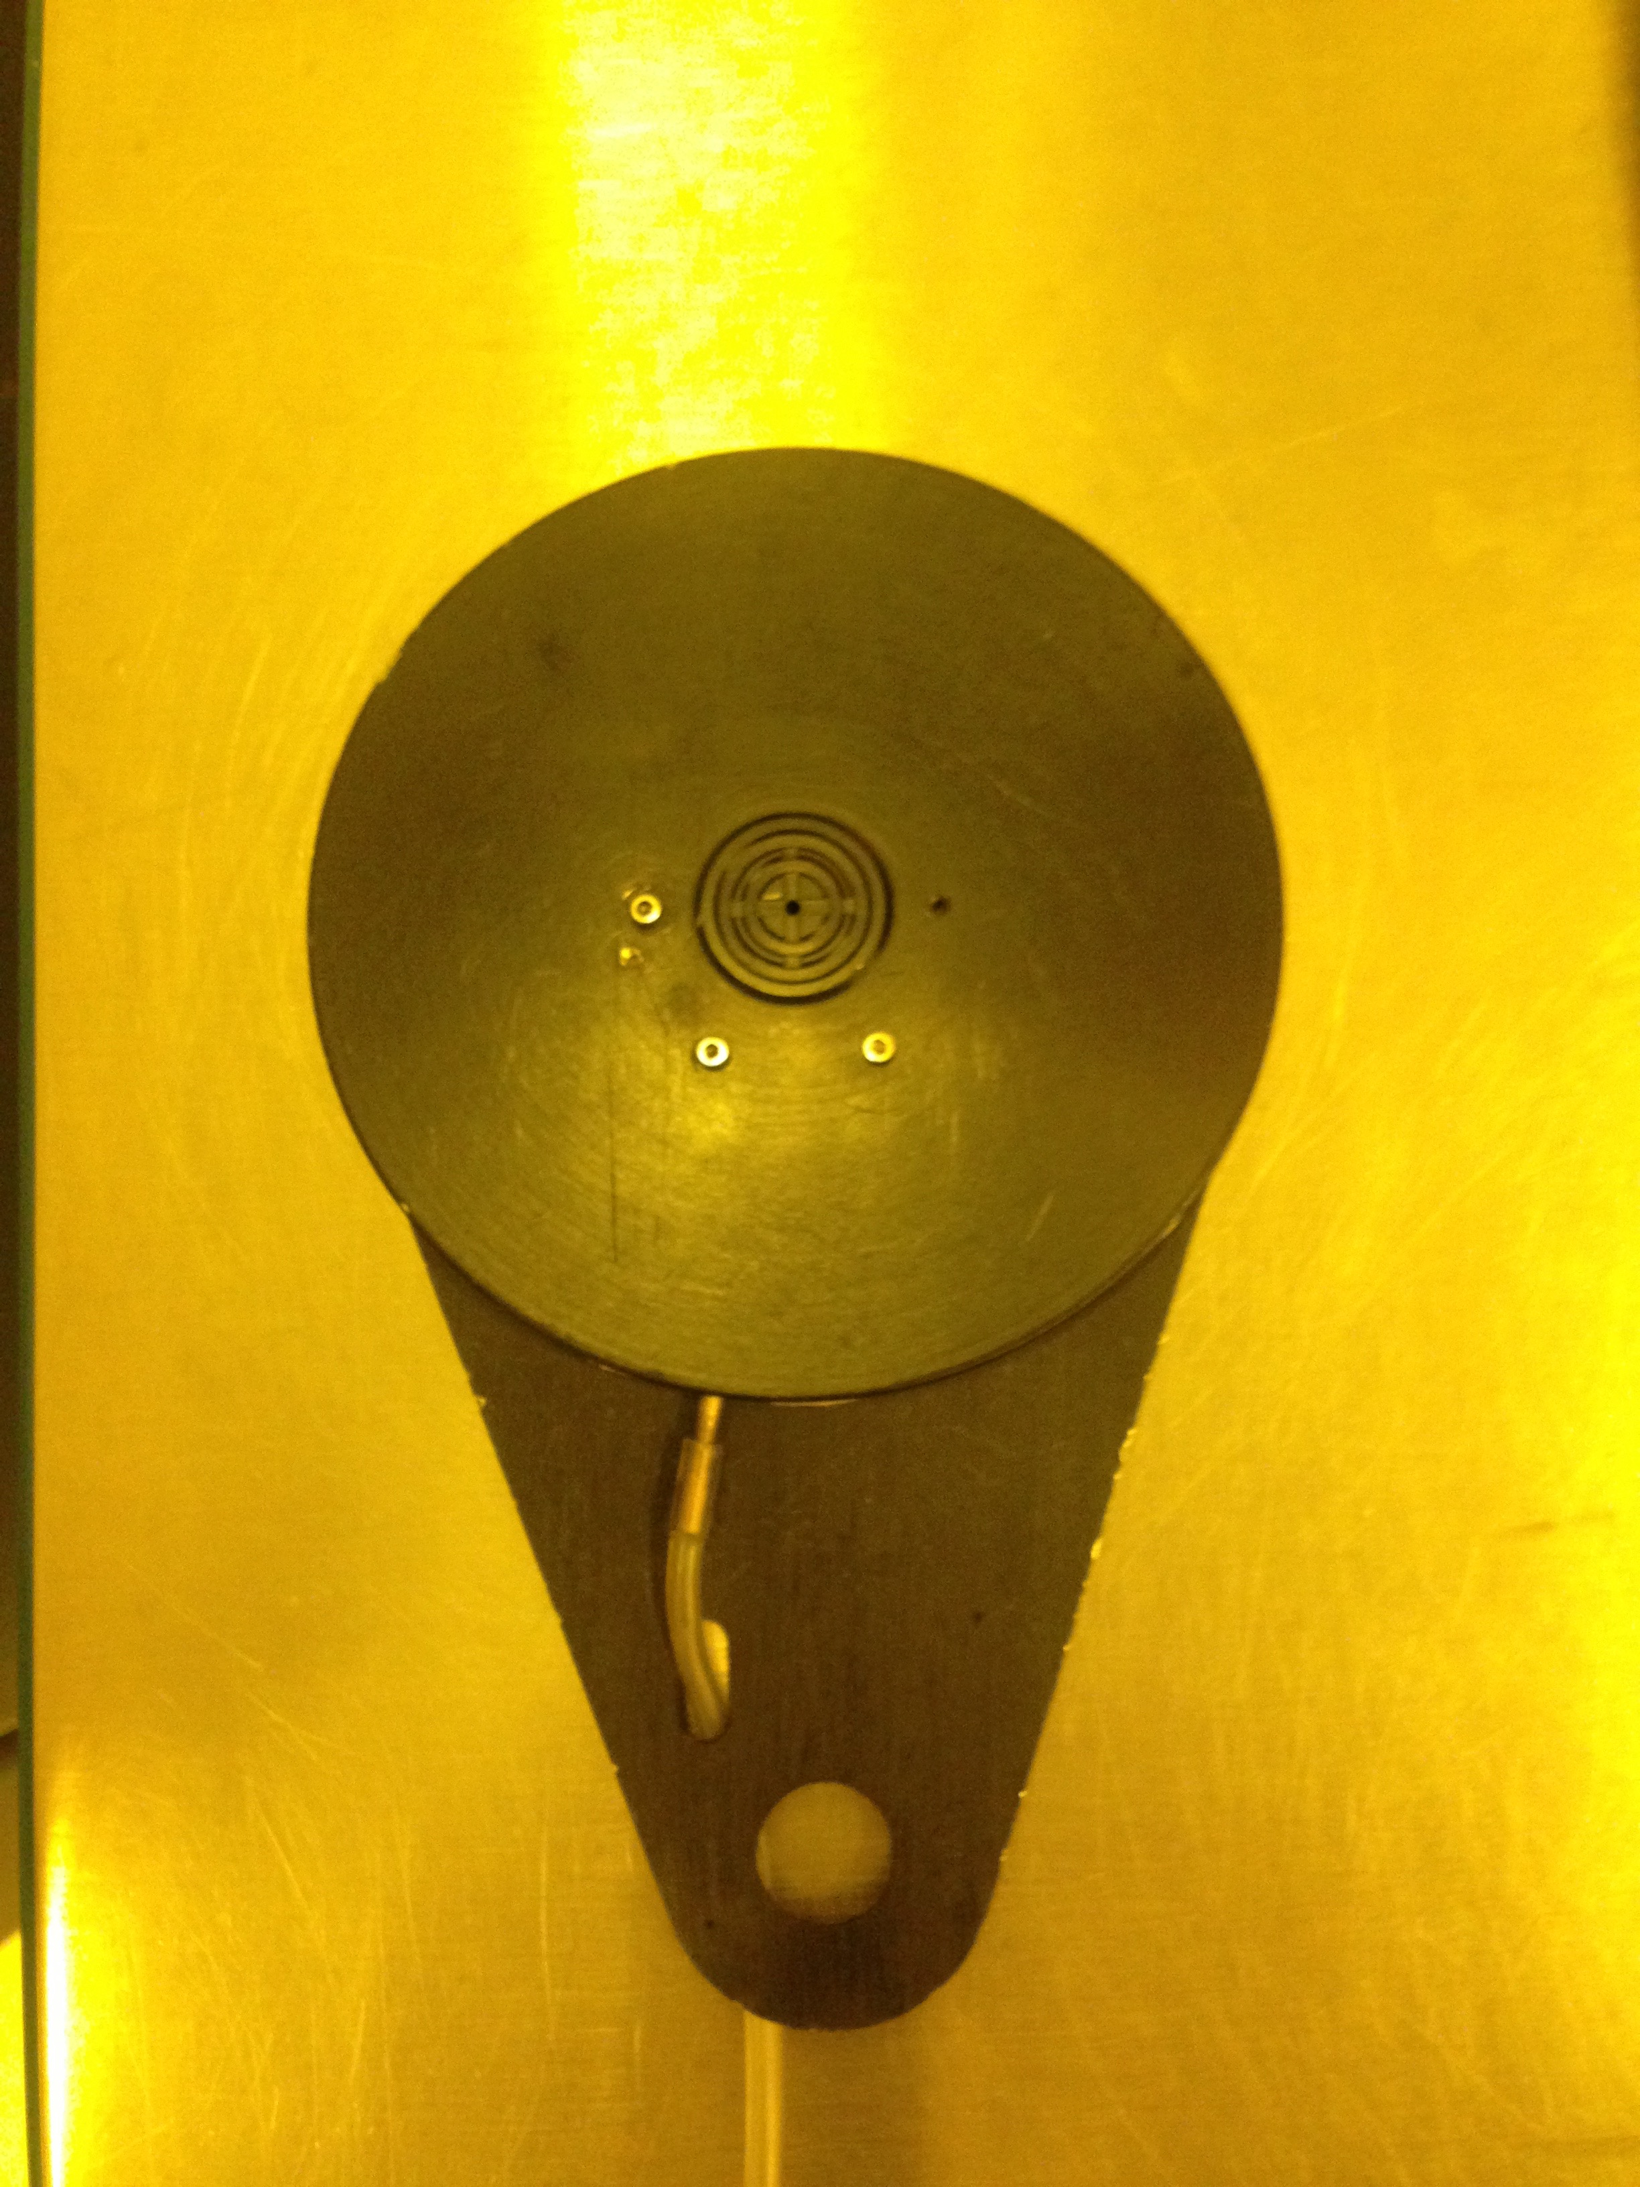
SMALL ¼ of 2” CHUCK
Substrate size: 1/4 of 2 inch (and smaller)
S=Substrate thickness: (620-820)mm
C=Chuck thickness (Bilja): 5.404mm
C=Chuck thickness with pink shim(Bilja): 5.804mm
Thickness (S+C)=(5.404+0.720)mm=6.124mm
TARGET thickness=6.121mm(+/-0.100mm)
Thinner substrates (≤350um), use pink shim 400um,
Substartes~500um use metal shim~230um
Pink shim~0.400mm=400um

Slide 4
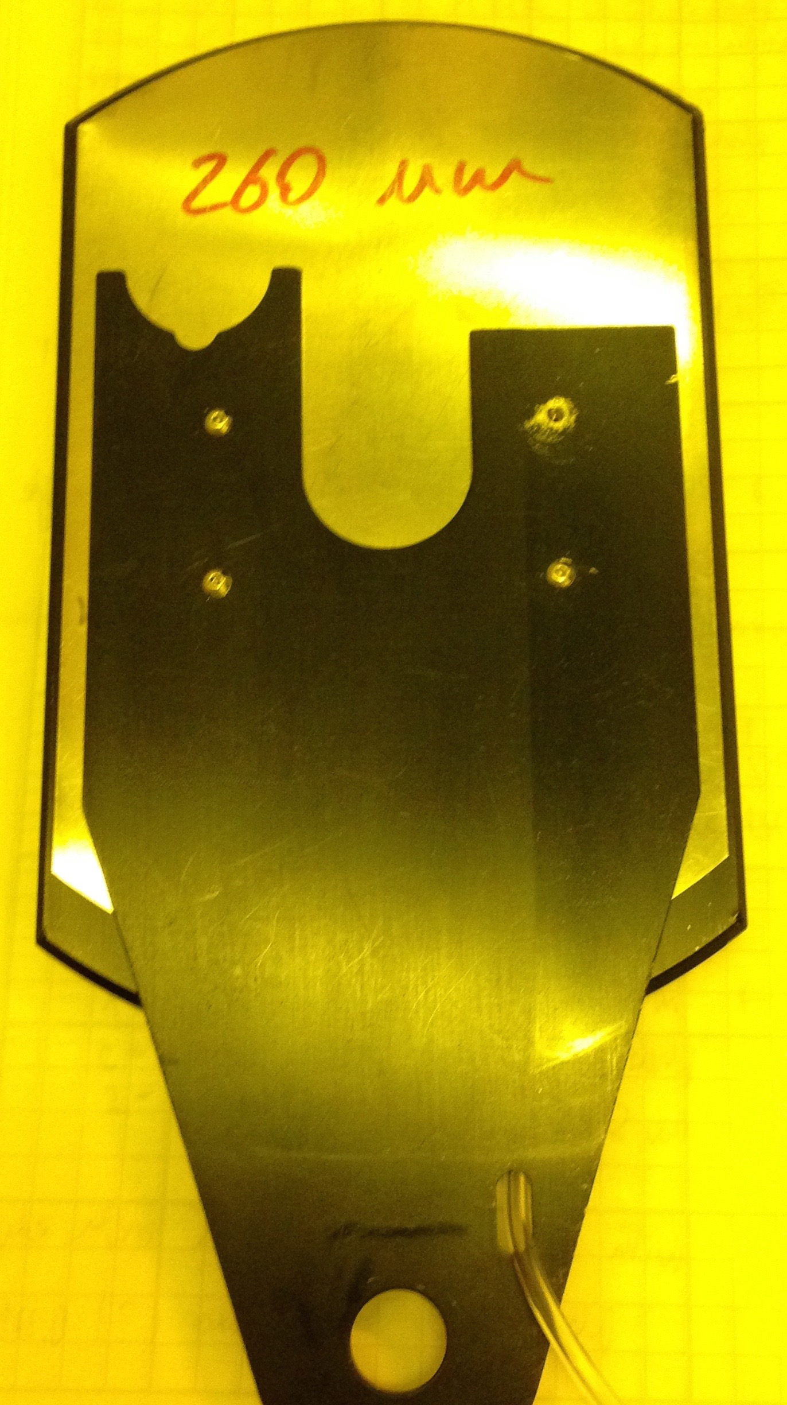
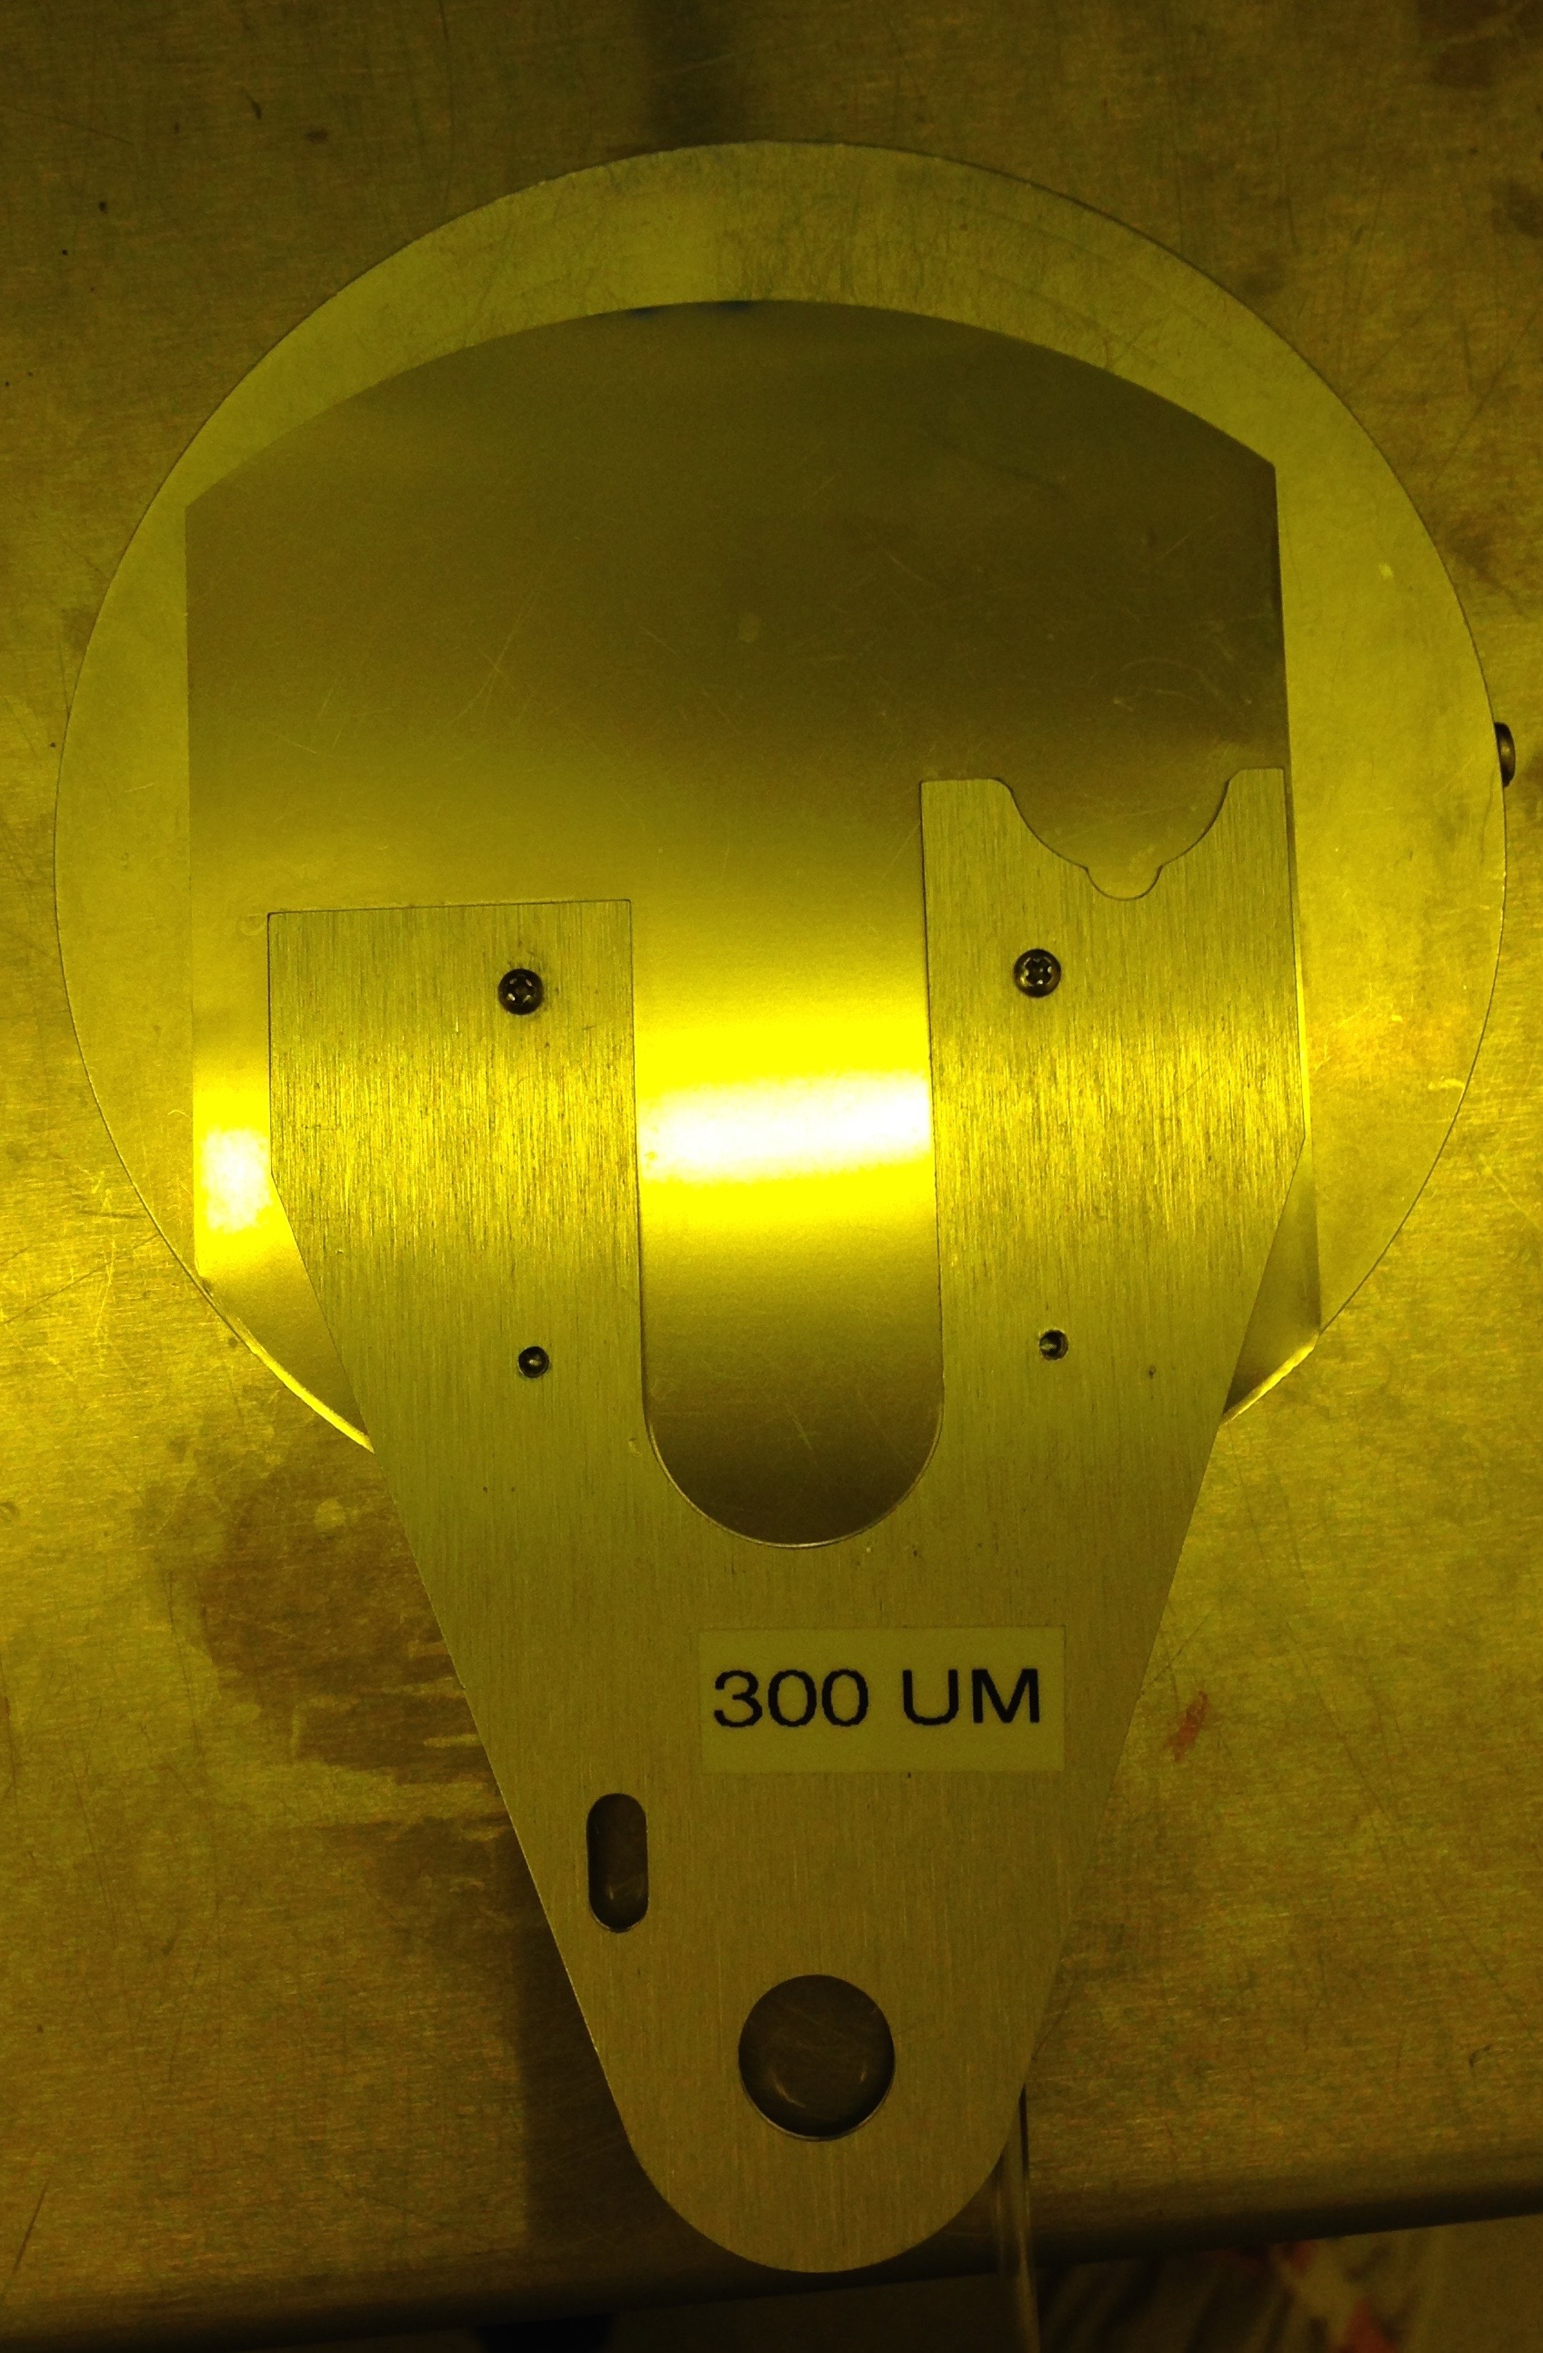
Attaching shim to the back side of chuck
Correct
Wrong

Slide 5
3C- Mat target thickness ~6.18mm

